Slide 1
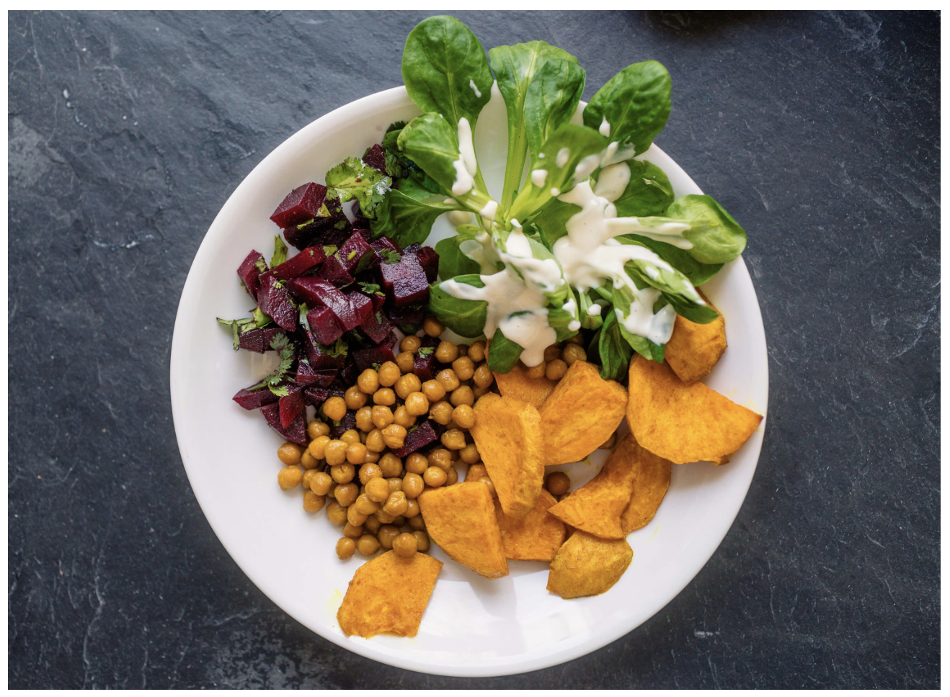
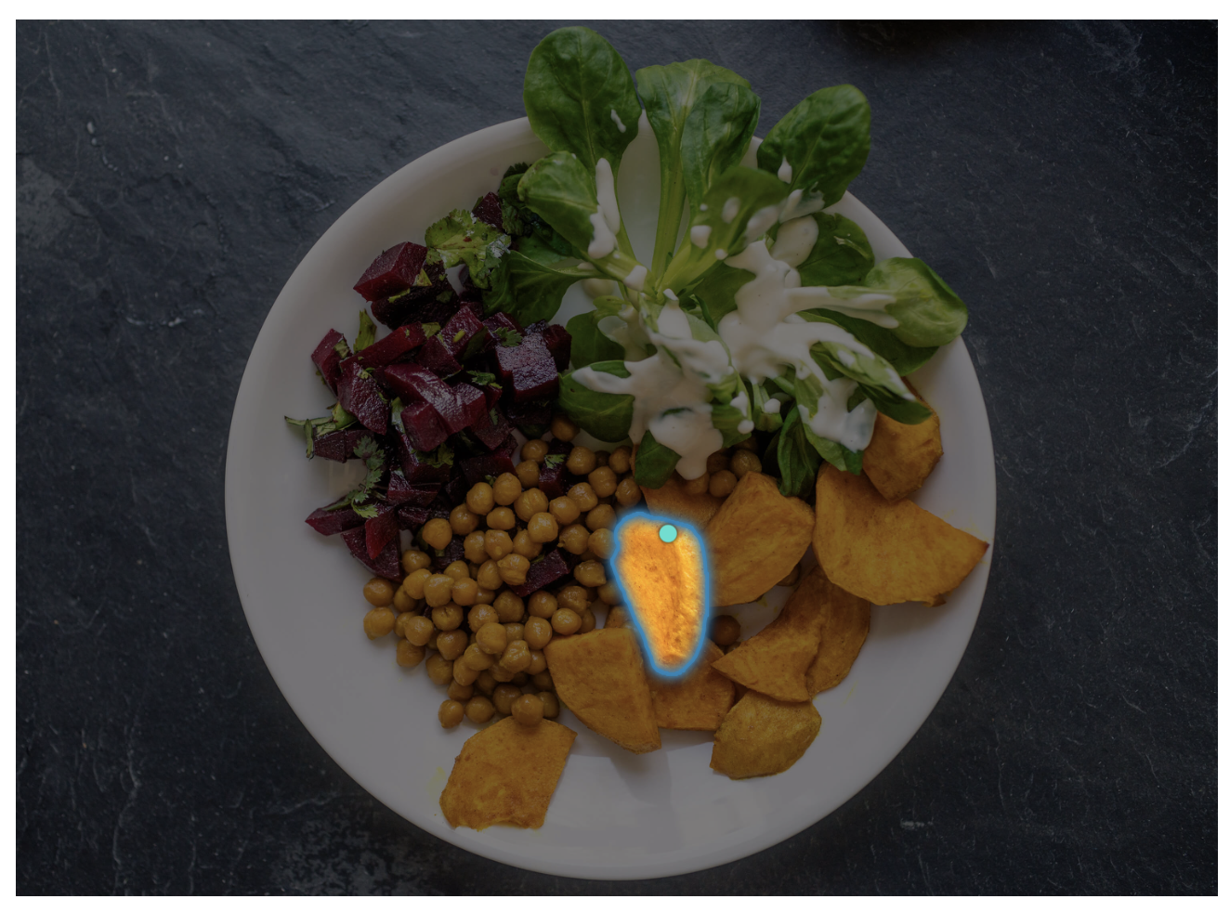
Sentiment Classification
Hello World
Deyu Qi (z5614224)
Hugh Wilson(zxxxxxxx)
Stefano Mezza (zxxxxxxx)
Jingying Gao (zxxxxxxx)
Zhongsui Guo (zxxxxxxx)

Slide 2
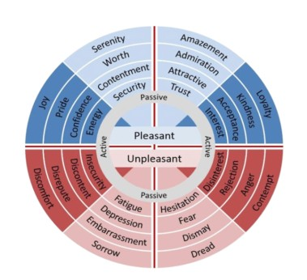
Motivation
Is it possible for Deep Learning Network to recognize different emotions through learning process? How is it expressed?
Emotion Classification: Identifying emotional expressions from tweets
One of the core tasks in NLP
Different areas of applications:
Psychology
Social Engineering
Commercial Feedback
Social Impact Analysis
…
Presenter: Sonit Singh (zxxxxxxx)

Slide 3
Problem Statement
Emotions are expressed in nuanced ways, which varies by collective or individual experiences, knowledge, and beliefs. Therefore, to understand emotion, as conveyed through text, a robust mechanism capable of capturing and modelling different linguistic nuances and phenomena is needed. Hence, the task of this project is to develop deep learning based solutions that can accurately identify emotion presented in textual data. (Need to modify!!!)
Presenter: Hugh Wilson (zxxxxxxx)

Slide 4
Literature Review
CARER: Contextualized Affect Representations for Emotion Recognition
They subtract emotional expressions of tweets by subjective graph – objective graph, categorizing tokens to connector words and subject words, and extract patterns which are strongly subjective to be classified.
More to expect…
Presenter: Hugh Wilson (zxxxxxxx)

Slide 5
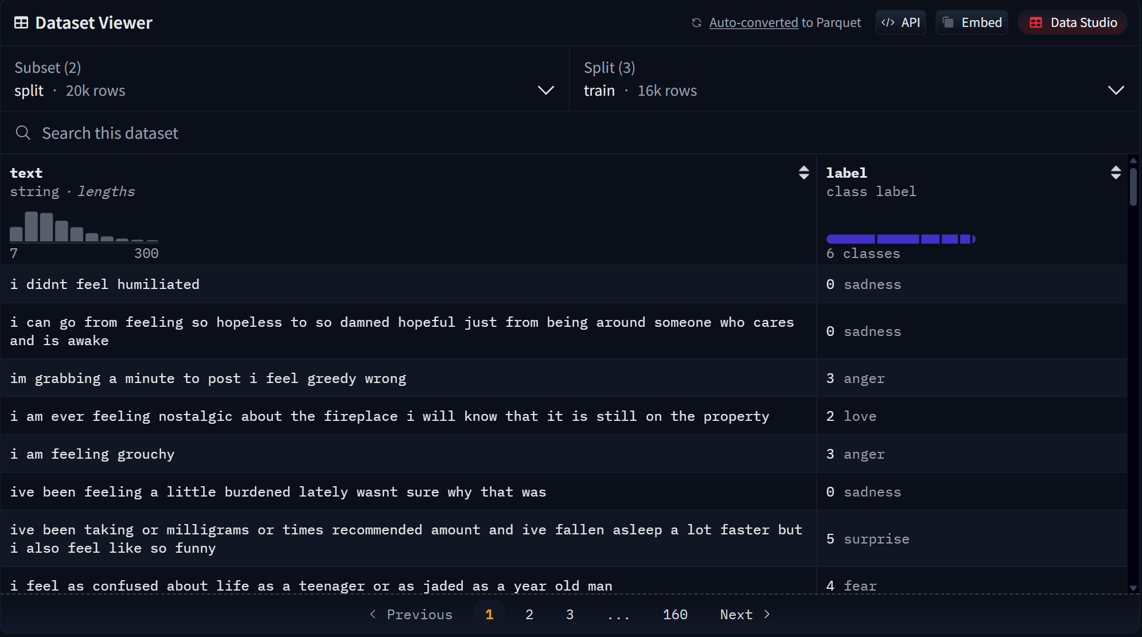
Dataset(s)
Dataset of twitter texts
6 categories of emotions
20000 text data
Presenter: Hugh Wilson (zxxxxxxx)

Slide 6
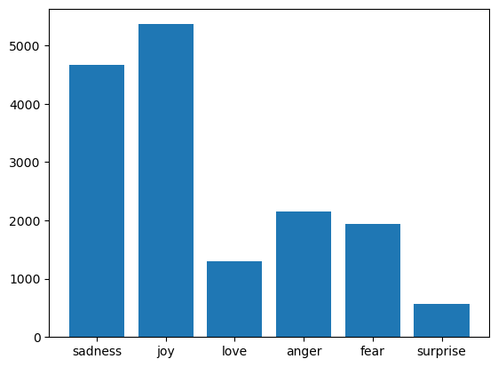
Data Analysis
Clean text
Imbalanced data
Presenter: Zhongsui Guo (zxxxxxxx)

Slide 7
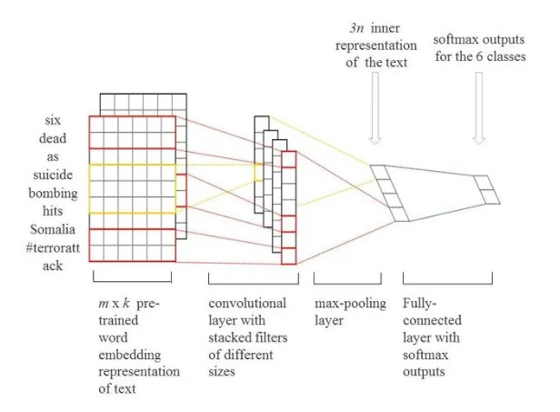
Convolutional Neural Network(CNN)
Used mainly in computer vision
Data manipulation
Presenter: Zhongsui Guo (zxxxxxxx)

Slide 8
LSTM
Details here …
Presenter: Zhongsui Guo (zxxxxxxx)

Slide 9
C-LSTM
Details here …
Presenter: Zhongsui Guo (zxxxxxxx)

Slide 10
BERT
Details here …
Presenter: Zhongsui Guo (zxxxxxxx)

Slide 11
Results
Details here …
Presenter: Zhongsui Guo (zxxxxxxx)

Slide 12
Discussion
Details here …
Presenter: Zhongsui Guo (zxxxxxxx)

Slide 13
Conclusion
Write here
Presenter: Zhongsui Guo (zxxxxxxx)

Slide 14

This Photo by Unknown Author is licensed under CC BY-SA

